Slide 1
AI in Smart Cities and Transportation
Presented by : Oman Malek

Slide 2
Smart Cities & AI: Revolutionizing How We Move
A Case Study on Singapore’s Intelligent Transport System
Focus on how AI improves transportation efficiency and sustainability
Explores real-world applications and future innovations

Slide 3
What is a Smart City?
A city that uses AI and help a Iot to improve daily life
Uses sensors, data, and automation to manage resources efficiently
Example: Smart traffic lights adjust timing based on congestion
Goal: Make cities safer, cleaner, and more efficient

Slide 4
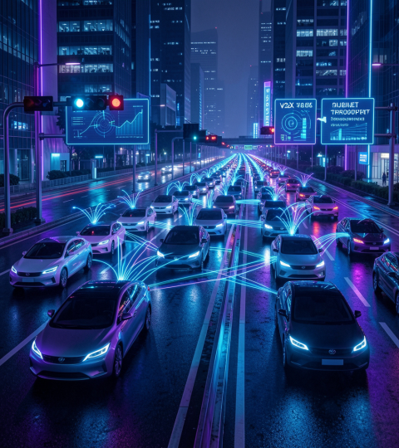
Case Study – Singapore’s Smart Mobility
Uses machine learning to predict traffic flow and congestion
Thousands of cameras and sensors collect real-time data
Electronic Road Pricing (ERP) helps reduce traffic jams
Government integrates transport systems into one smart network

Slide 5
Key Benefits – Why Use AI?
Reduced travel time through optimized traffic signals
Emergency vehicles receive priority routes
Lower fuel consumption and reduced pollution
Improved public transport scheduling and reliability

Slide 6
Implementation Challenges
High installation and maintenance costs
Difficulty integrating with older infrastructure
Need for skilled workforce to manage AI systems
Cybersecurity risks and system failures

Slide 7
Ethical Considerations
Privacy concerns due to continuous monitoring
Risk of misuse of collected data
Need to ensure fairness across all communities
Importance of transparency and regulations

Slide 8
Societal Impact
Improved mobility for elderly and disabled citizens
Better urban planning and reduced congestion
Potential job loss in traditional transport roles
New job opportunities in tech and data fields

Slide 9
Future Trends
Digital twins for testing city changes virtually
Autonomous vehicles and smart public transport
Integration with renewable energy systems
Expansion of AI in urban planning and safety

Slide 10
Recommendations
Focus on solving real problems for citizens
Ensure transparency in data collection
Invest in secure and scalable infrastructure
Encourage public awareness and participation

Slide 11
Conclusion
AI acts as the brain of a smart city
Improves efficiency, safety, and sustainability
Singapore shows a successful real-world example
Future cities will rely heavily on AI-driven systems

Slide 12
Thank you!

